Slide 1



Revenue and profit analysis, discovering the weak links
View in Power BI
Last data refresh:
7/26/2025 9:19:15 AM UTC
Downloaded at:
7/26/2025 9:34:38 AM UTC

Slide 2
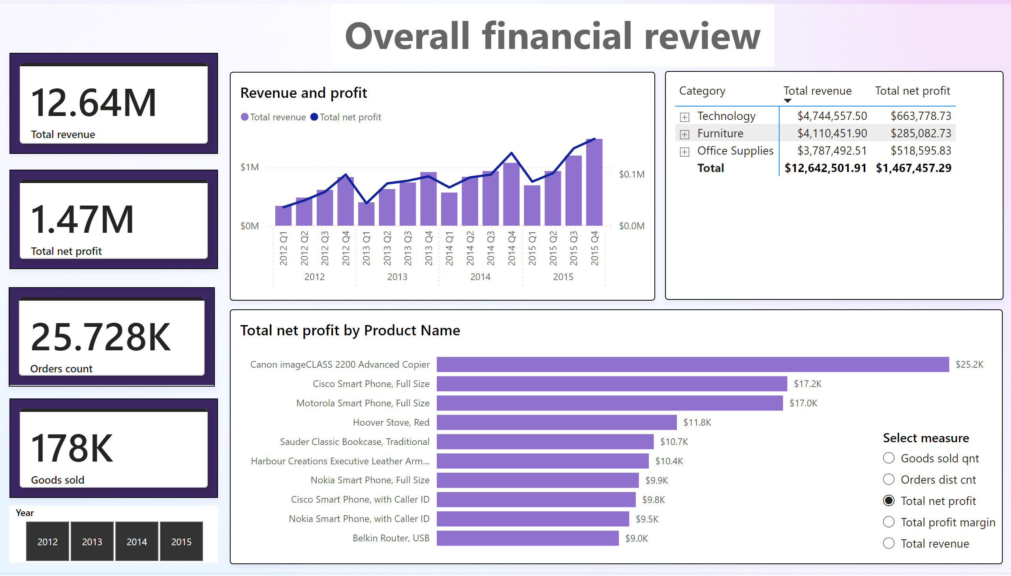
main
Notes:
Revenue and profit
No alt text provided
slicer
No alt text provided
cardVisual
No alt text provided
cardVisual
No alt text provided
cardVisual
No alt text provided
cardVisual
No alt text provided
textbox
No alt text provided
barChart
No alt text provided
slicer
No alt text provided
pivotTable
No alt text provided

Slide 3
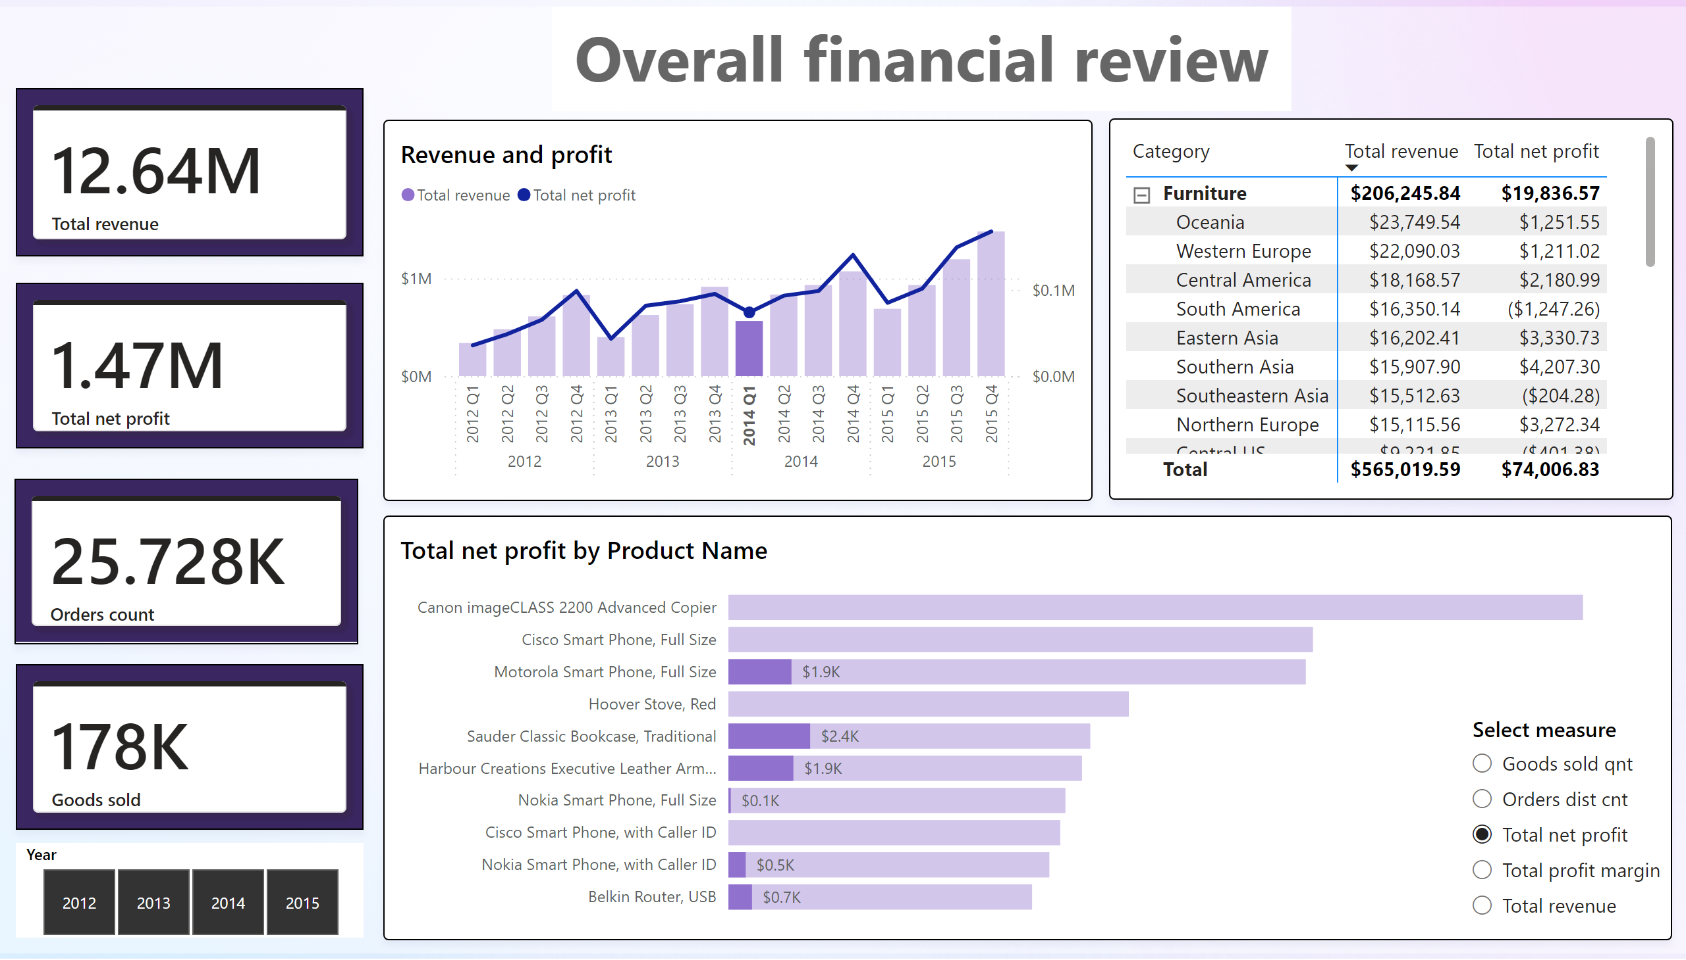
2014 Q1

Slide 4
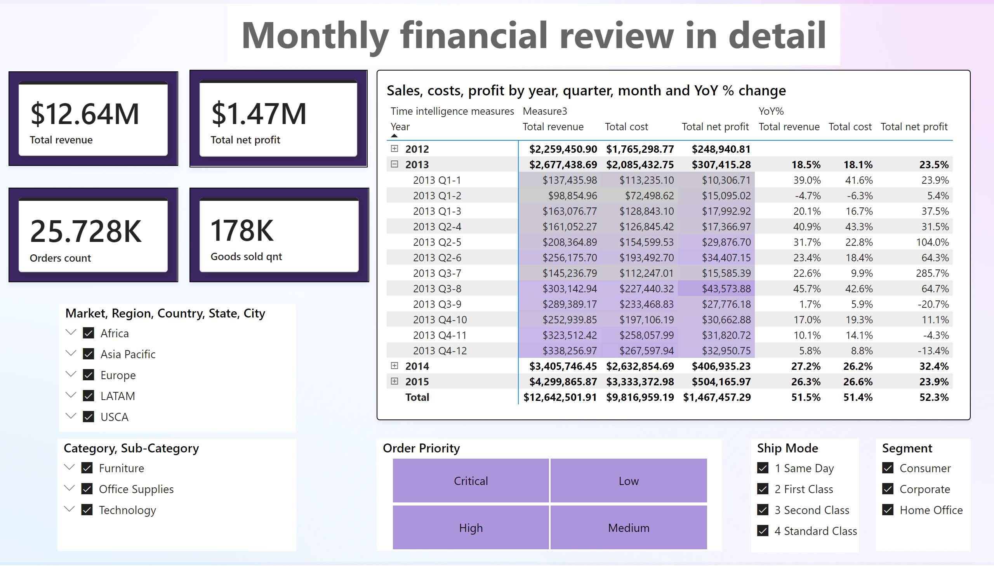

Slide 5
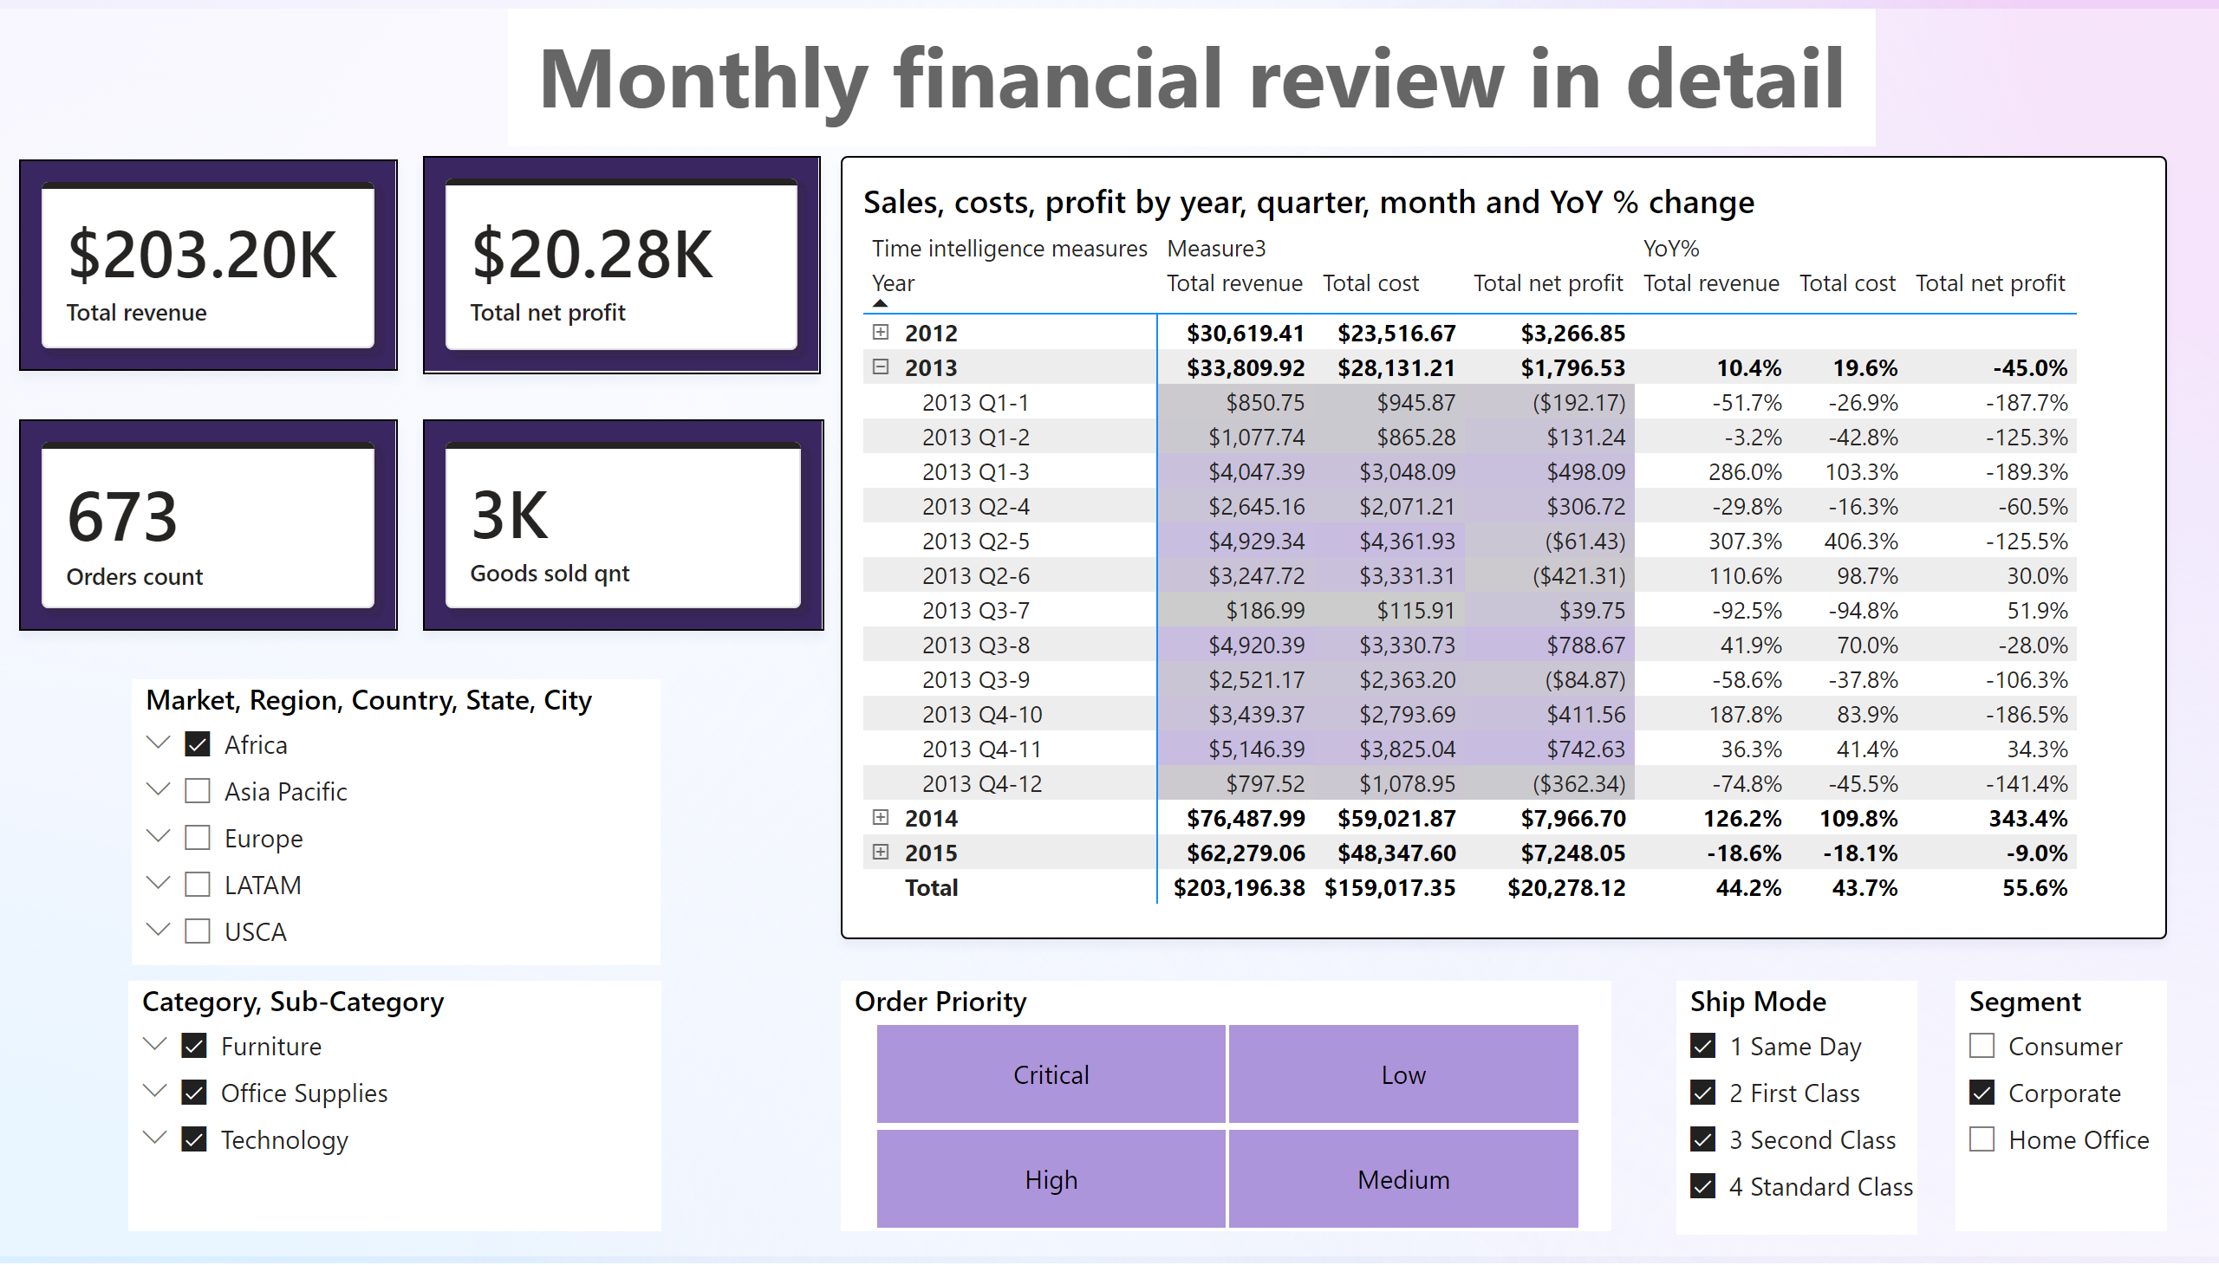

Slide 6
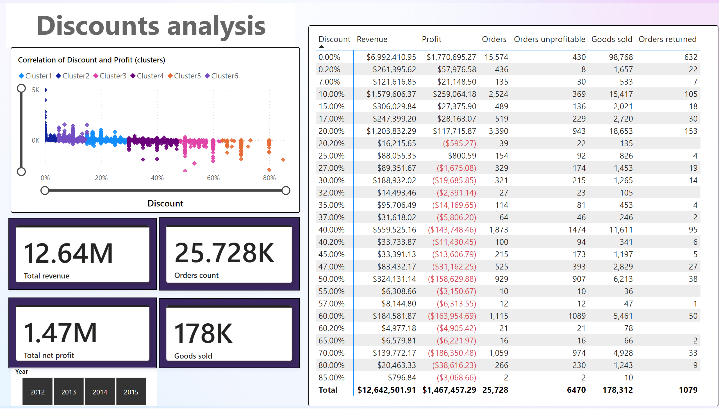

Slide 7
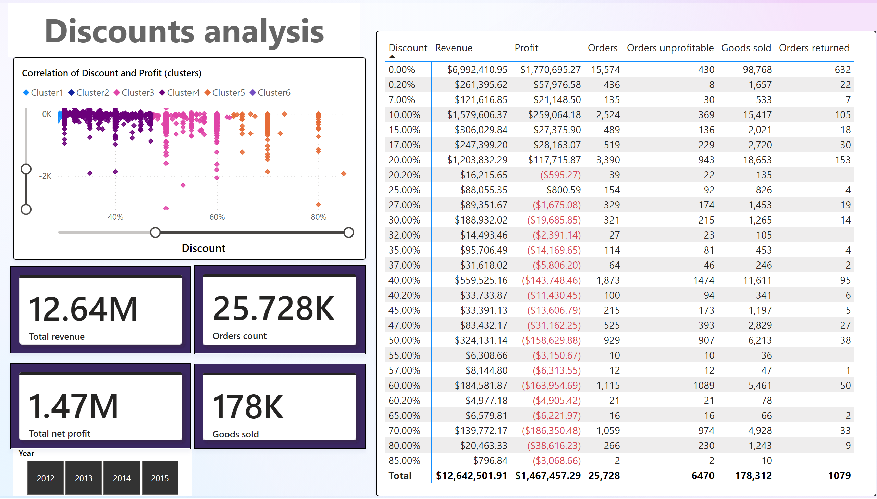

Slide 8
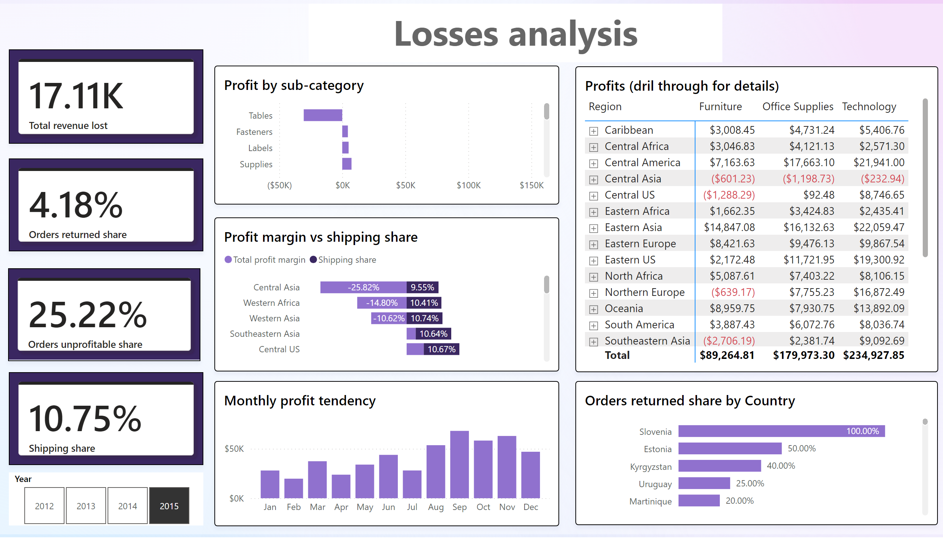

Slide 9
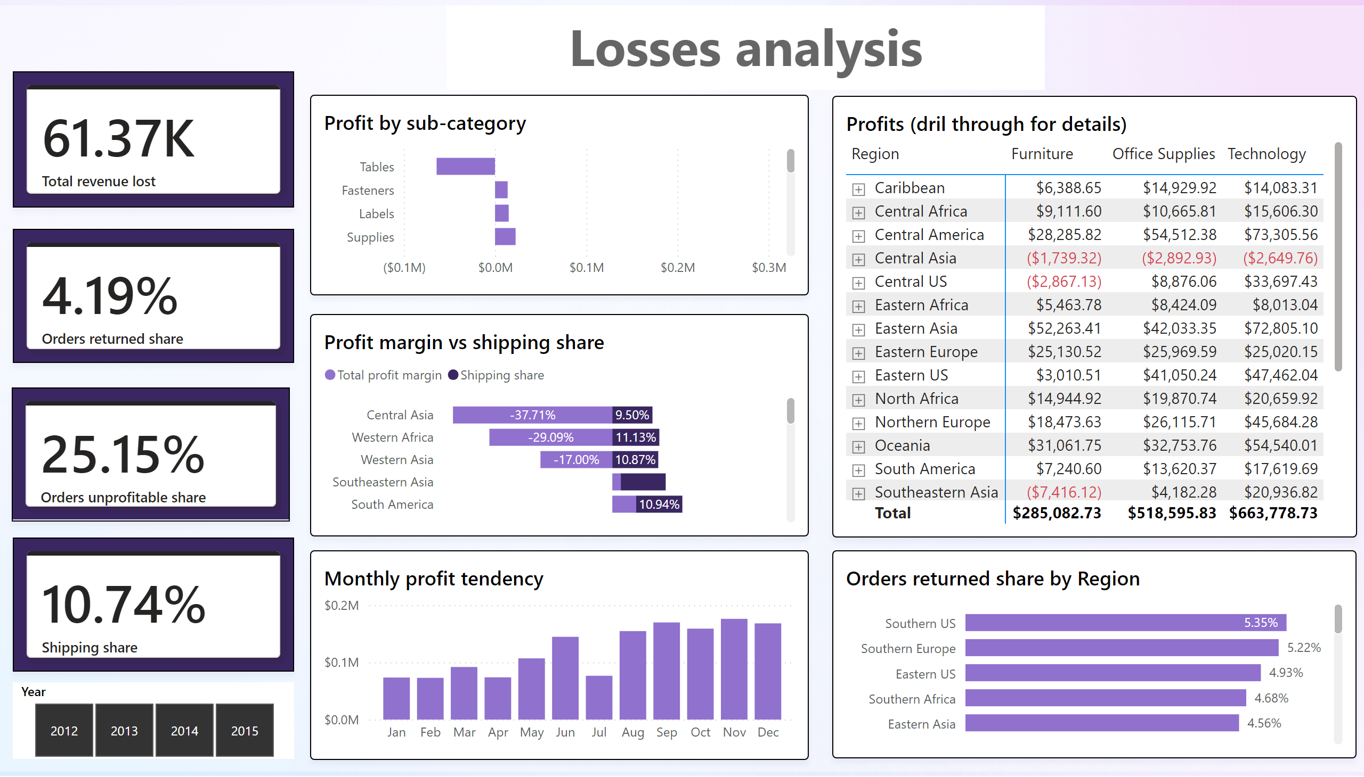

Slide 10
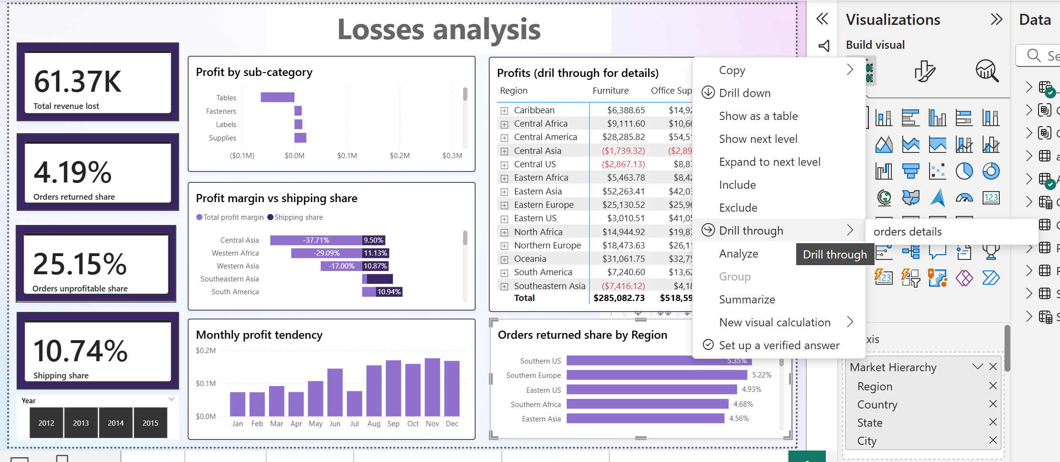

Slide 11
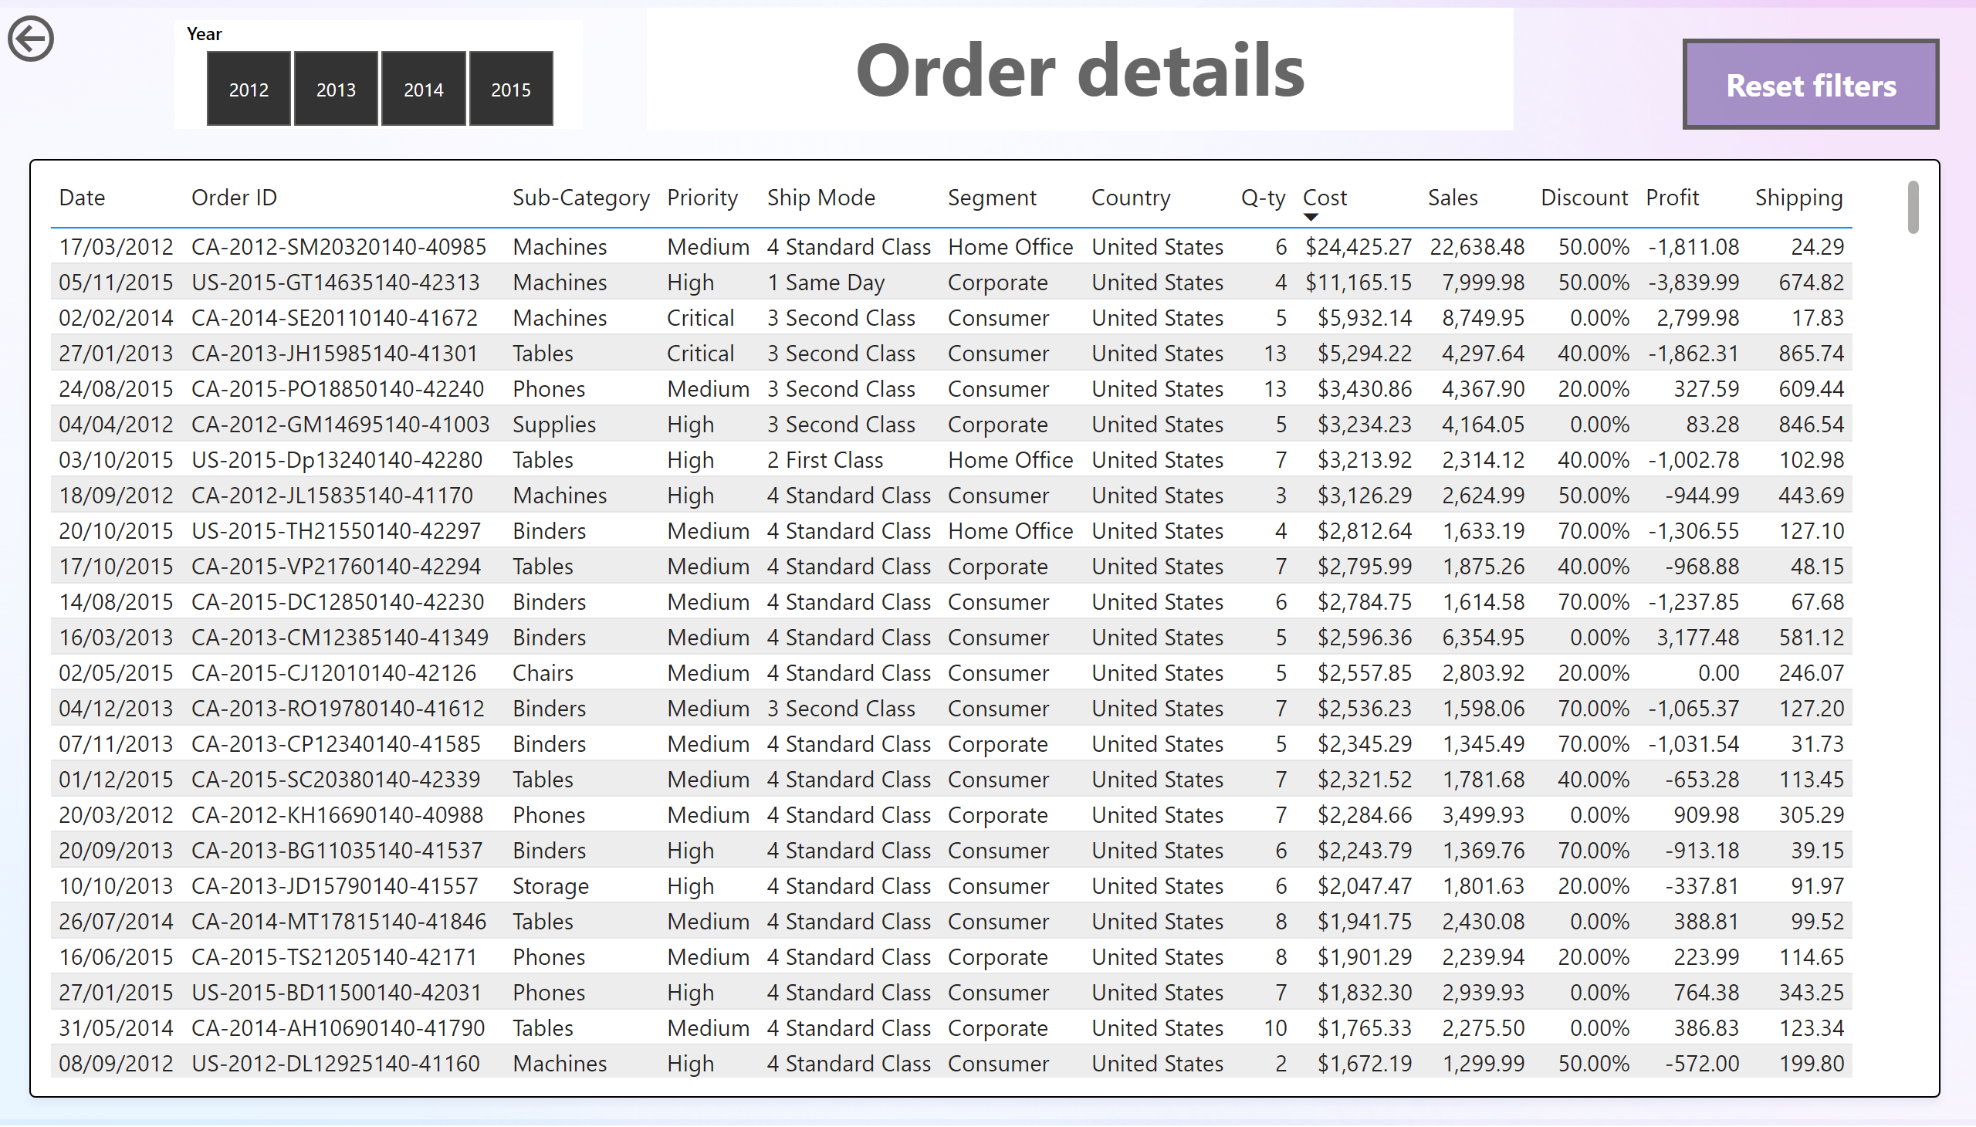

Slide 12
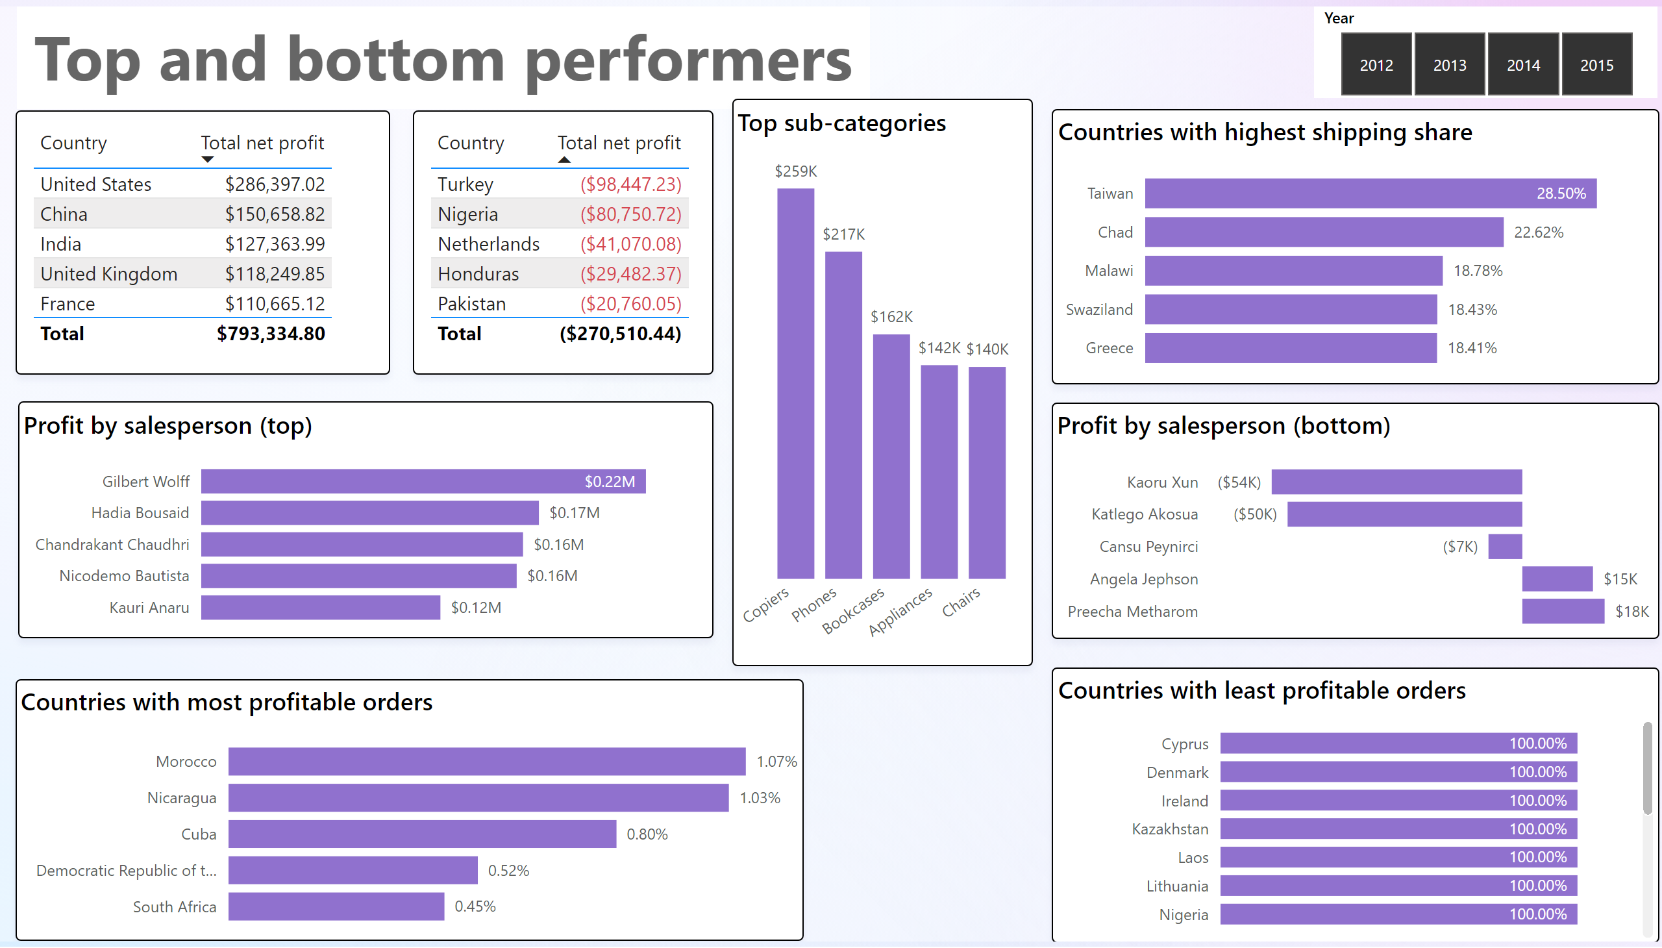

Slide 13
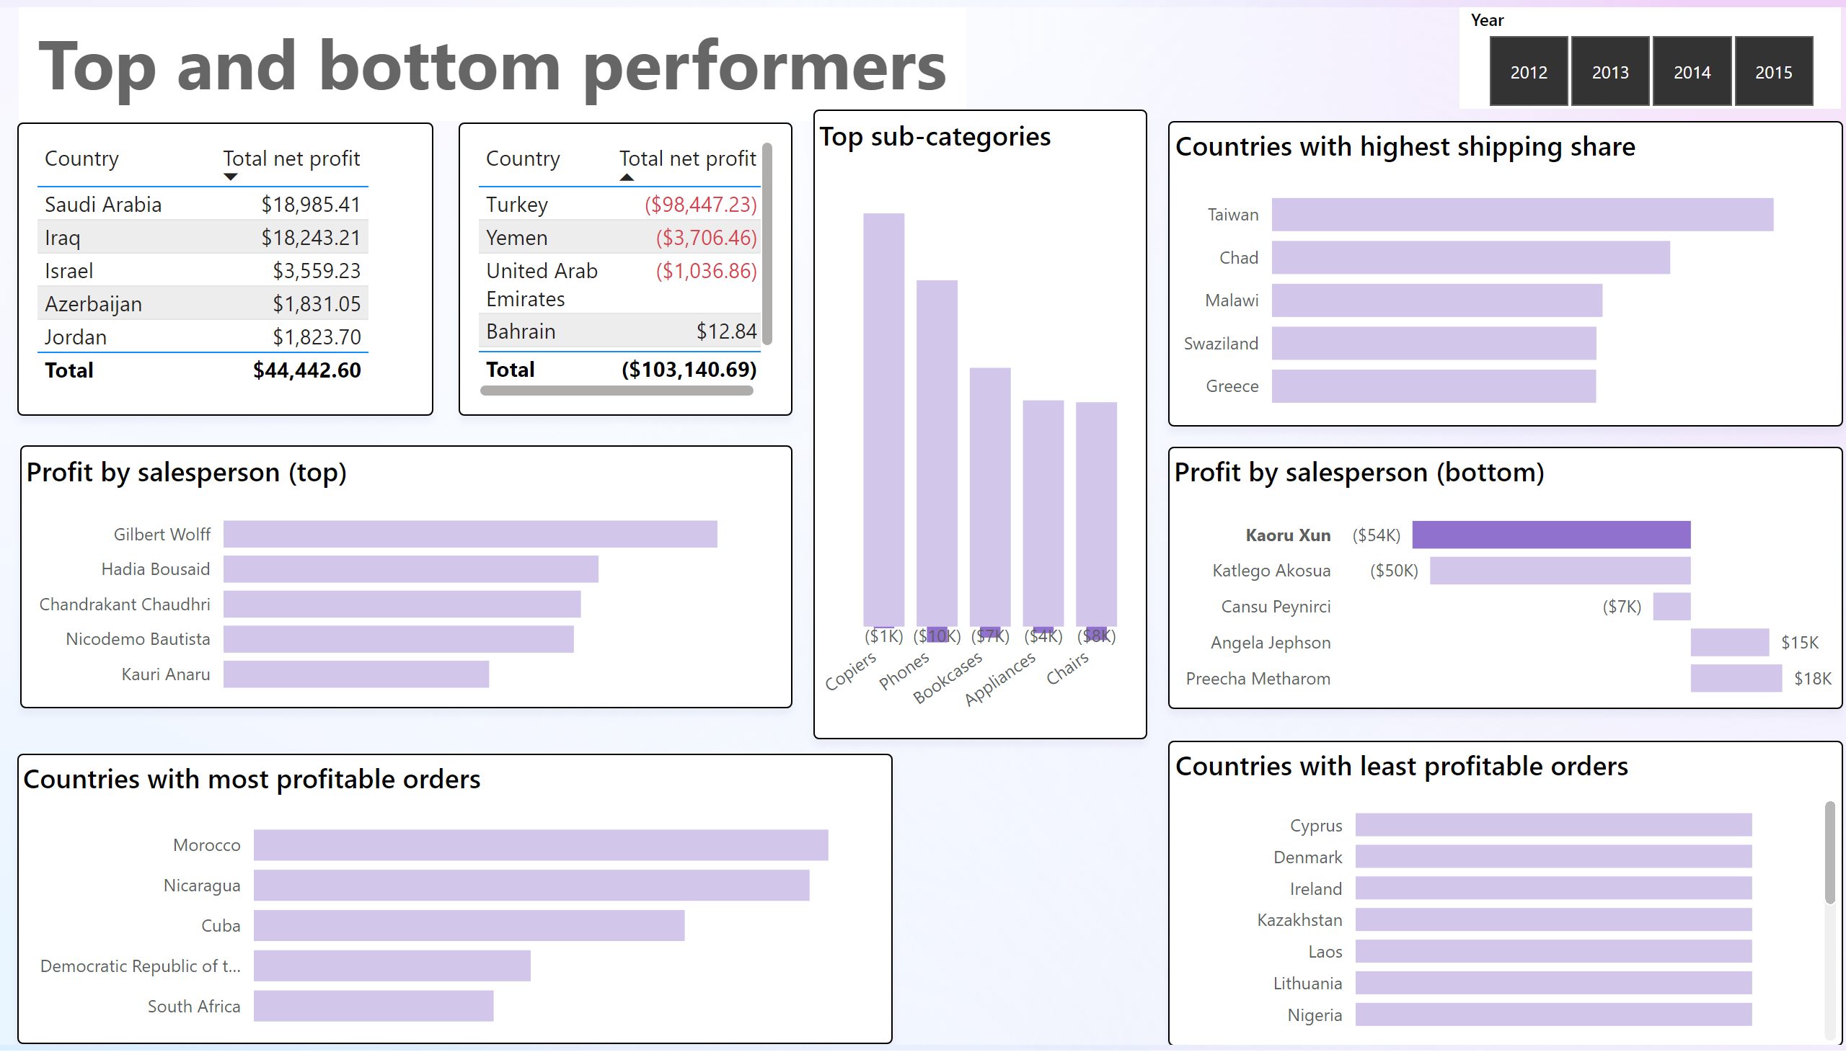

Slide 14
I thank you for your questions and time.
View in Power BI
Last data refresh:
7/26/2025 9:19:15 AM UTC
Downloaded at:
7/26/2025 9:34:38 AM UTC

